Slide 1
Supervised Multi-topology Network
Cross-diffusion for Population-driven Brain
Network Atlas Estimation
Presented by Qazi Danish Ayub and Aiman Younas

Slide 2
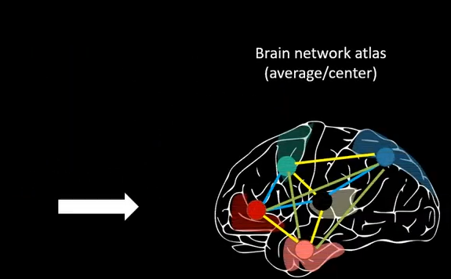
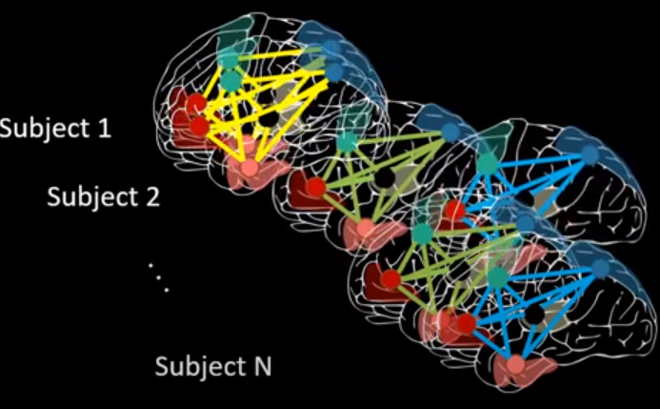
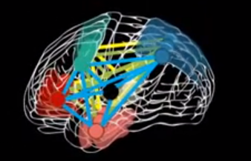
Problem Statement
General Context
Integrate a set of functional networks to define a unified brain network atlas.

Slide 3
Previous methods
Diffusive shrinking graphs(rekik et al, 2017):
Introduced a brain network atlas from a population of both morphological and functional brain networks using diffusive-striking graph technique.
netNorm(Dhifallah et al, 2019):
Designed a sample selection technique followed up by a graph diffusion and fusion step to create a unified brain network atlas.
Brain network atlas-guided feature selection (NAGFS) method (Mihiri et al, 2020):
Estimated a brain network atlas-guided feature selection (NAFGS) method to differentiate the healthy from the disordered brain connectome.

Slide 4
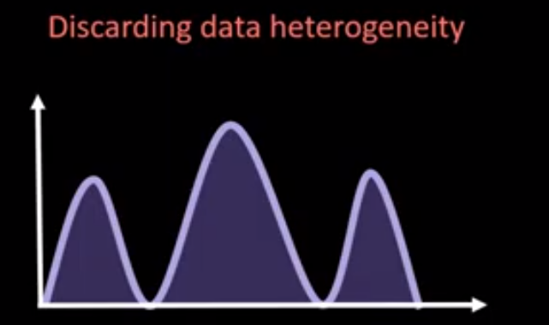
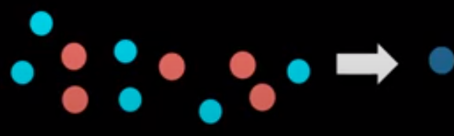
Limitations
-All the methods have relied on Similar network Fusion techniques(SNF)
-Non-linearly diffuses and fuses brain network without considering their heterogeneous distribution.
-Diffusion and Fusion techniques are implemented in fully unsupervised manner.

Slide 5
Proposed SM-netFusion Framework
Supervised network cross-diffusion baked on graph topological measures (SM-netFusion) by enhancing the non-linear fusion process using a weighted mixture of multi-topological measures.
By clustering similar functional brain networks into non-overlapping subspaces using multiple kernels, we can capture potential data distribution heterogeneity with different bandwidths.
(+) Handles data heterogeneity at different bandwidths.
Supervisedly learn a weighted combination of multi-topological measures which nicely characterize both local and global relationships
(+) preverves the heterogeneous distribution of the data in a specific class.
(+) Improves the representativeness and centeredness of the estimated multi-topology BNA

Slide 6
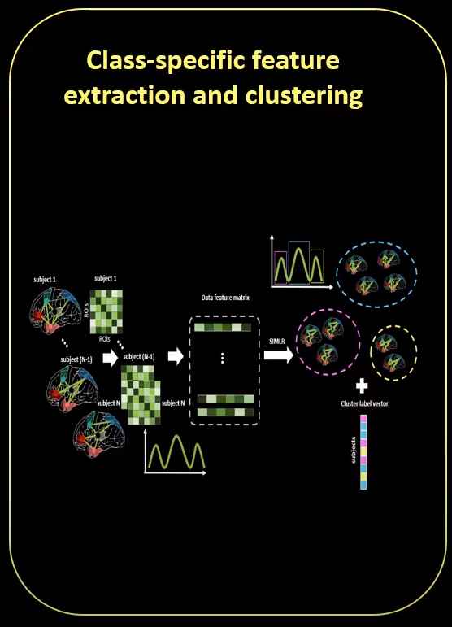
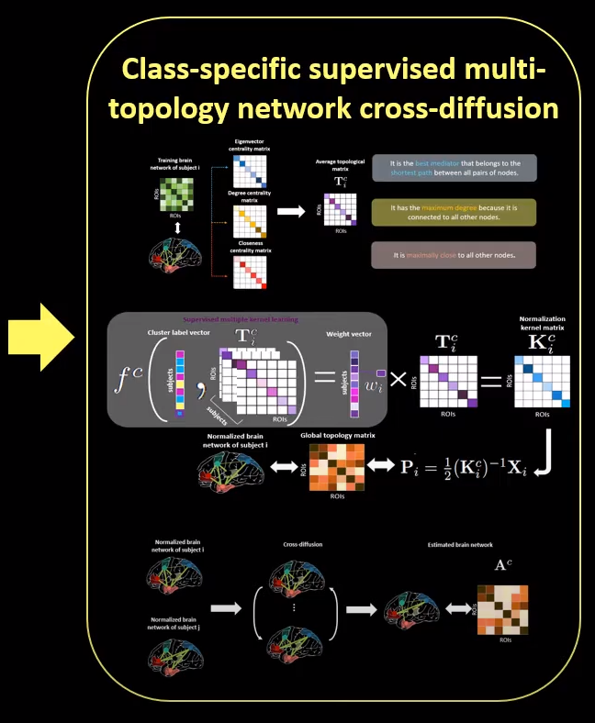
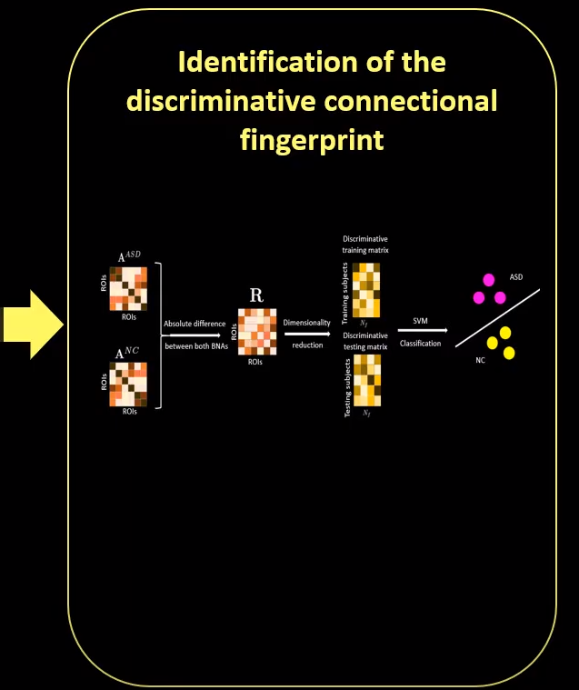
Proposed SM-netFusion Framework

Slide 7
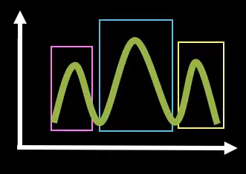
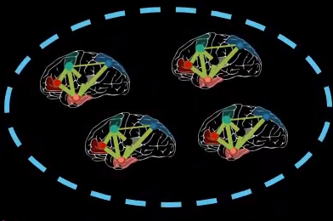
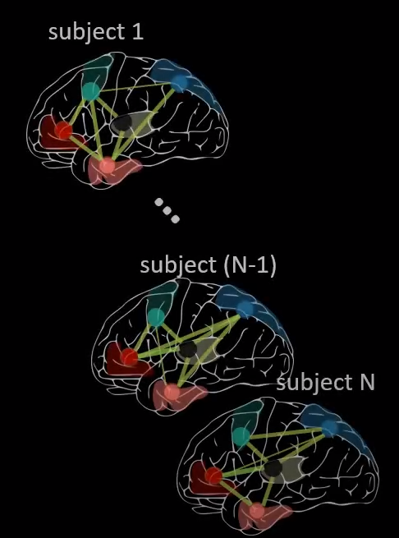
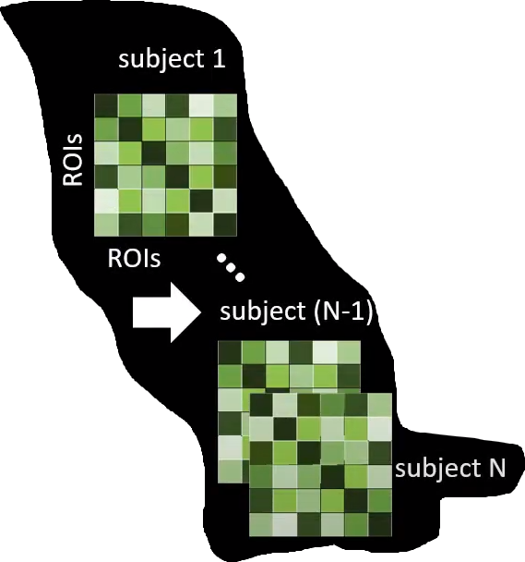
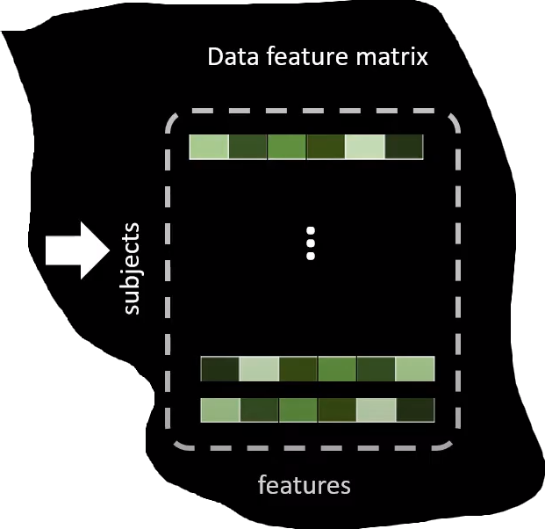
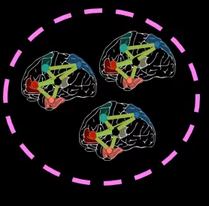
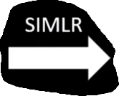
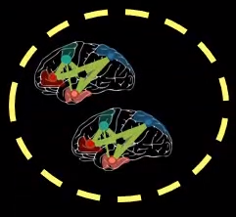
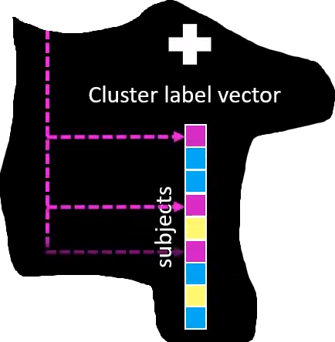
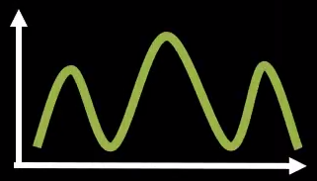
Class-specific feature extraction and clustering

Slide 8
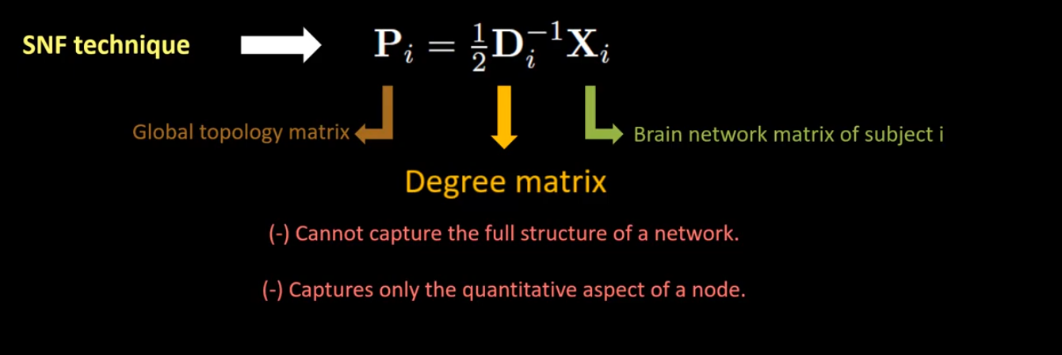
B) Class-specific supervised multi-topology network cross-
diffusion

Slide 9
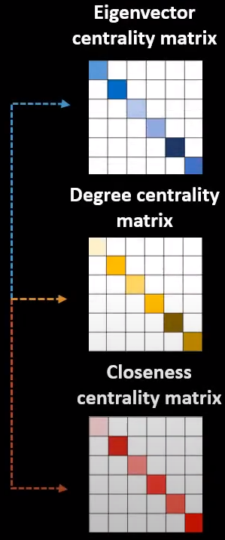
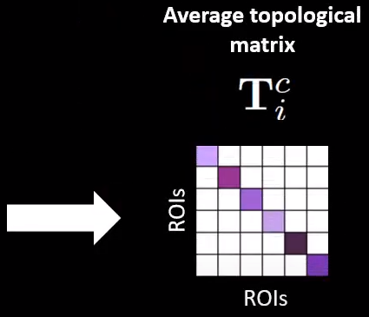

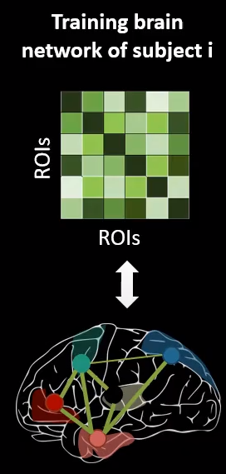


Step 1: Class-specific multi-topology brain network construction

Slide 10
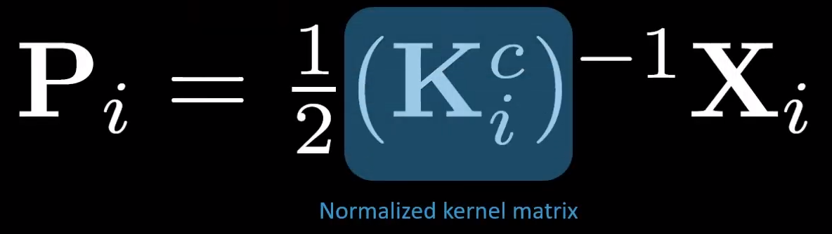

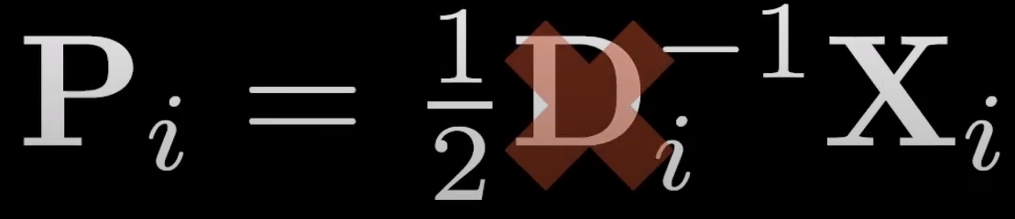
Step-2 Normalization of the global topology for a specific class

Slide 11
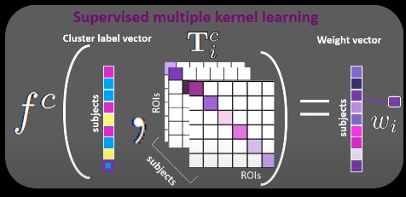
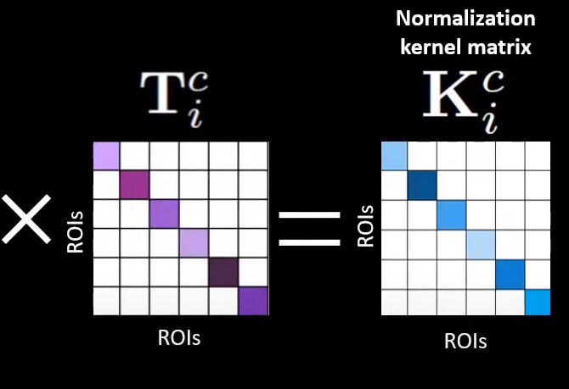
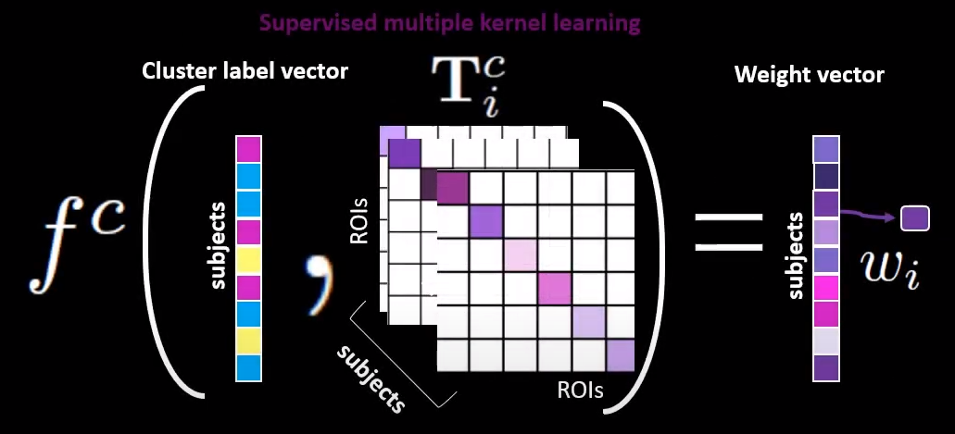
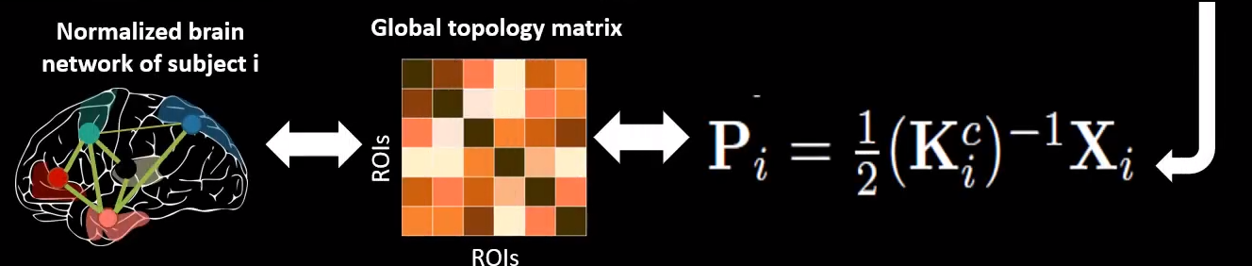
Class-specific supervised multi-topology network cross-diffusion
Step 2: Normalization of the global topology matrix for a specific class

Slide 12
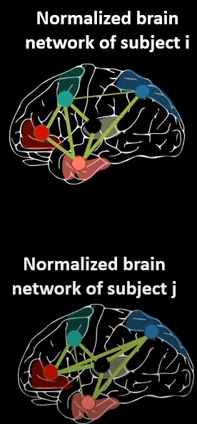
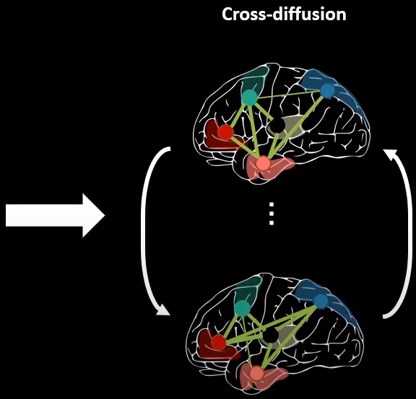
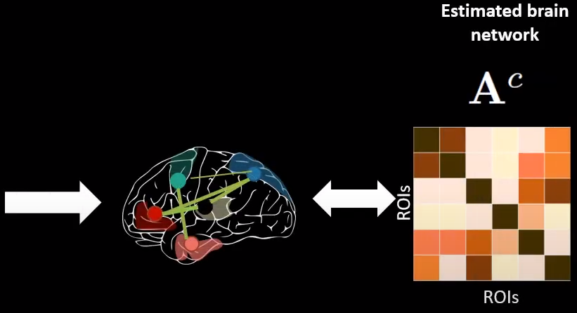
Step-3 Class-specific cross diffusion process

Slide 13
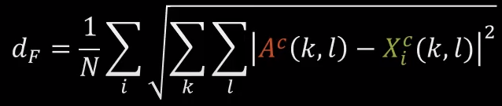
Experiments
Dataset
505 functional connectomes (266 ASD and 239 NC) from the Autism Brain Imaging Data Exchange (ABIDE¹) preprocesses public dataset.
Representativeness evaluation metric
Frobenius distance d_{F} between the estimated template A and each brain network X_{i}^{c} of subject i and averaged across subjects:
We evaluated SM-Fusion representativeness using five-fold cross-validation.

Slide 14
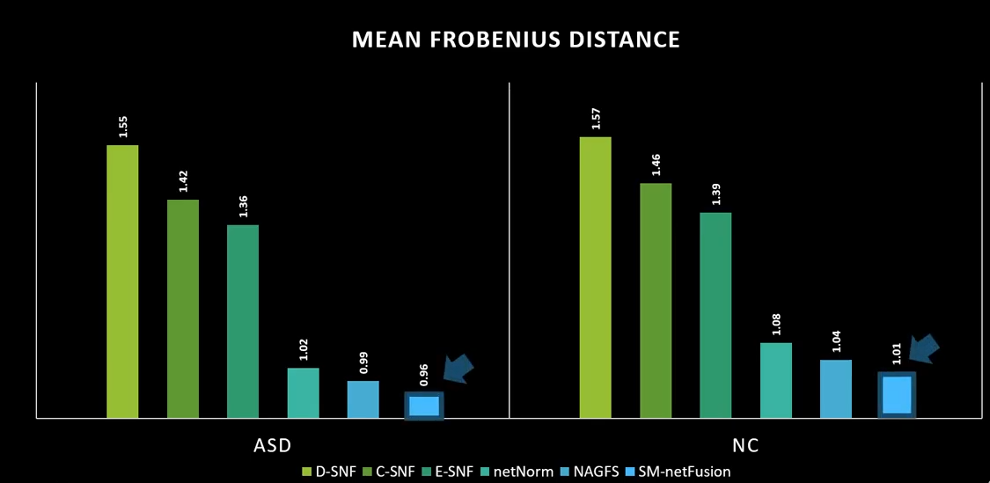
Results

Slide 15
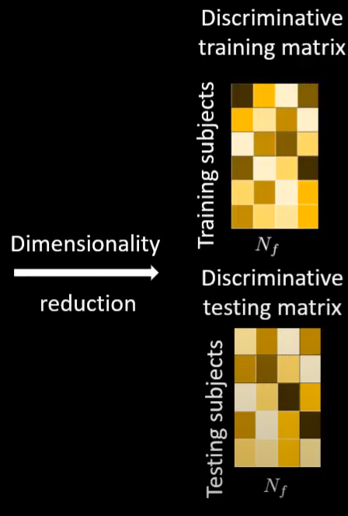
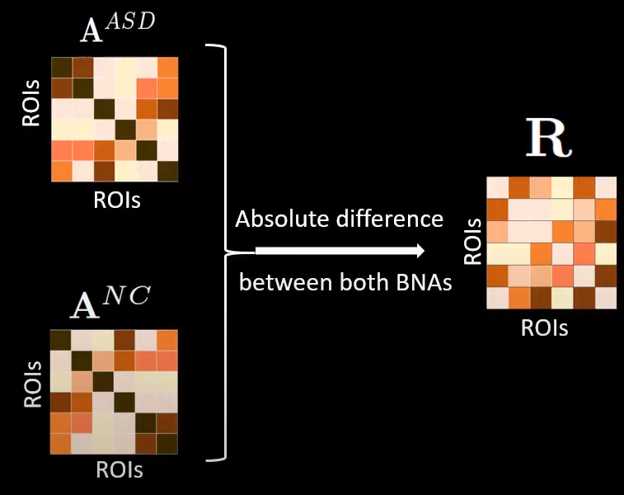
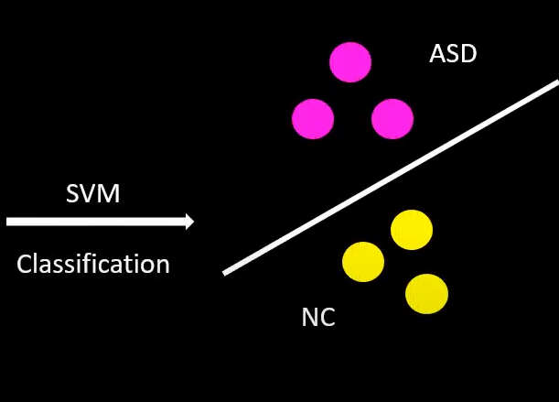
C) Identification of the discriminative connectional biomarker

Slide 16
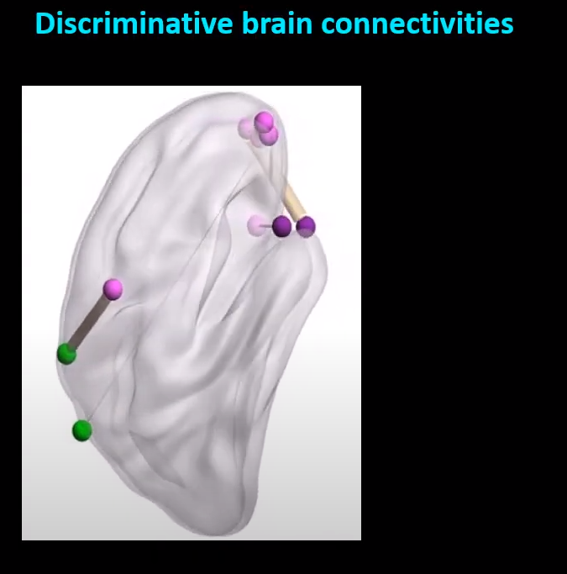
Neuro Biomarkers

Slide 17
Conclusion
Summary
SM-netFusion is the first framework for supervised network cross-diffusion based on graph topological measures for estimating a representative and discriminative brain network atlas.
Outperformed both baseline and state of-of-the-art methods
Major findings
Supervised cross-diffusion process > handles data heterogeneity
Can be leveraged to design an efficient feature selection method > training predictive learners in network neuroscience
Spot connectional fingerprints of a disorder > helps clinicians better interpret the altered brain connections
Can be applied to brain networks derived from any neuroimaging modality > generic method.
Future work
Evaluate on larger connectomic datasets covering a diverse range of neurological disorders

Slide 18
Questions
How to visualise brain anatomy using graphs?
How to use topological measurements to determine important regions?
How to distinguish between a healthy and a non-healthy brain?

Slide 19



